Slide 1
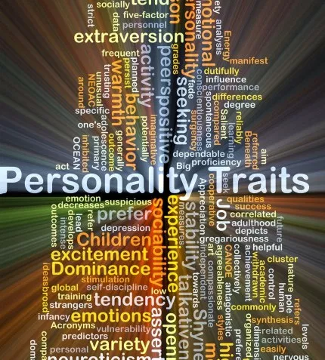
Behavior Prediction based on Handwriting using Machine Learning
M.Sc. Data Analytics
Group D
Poonam Dhoot
10399137

Slide 2
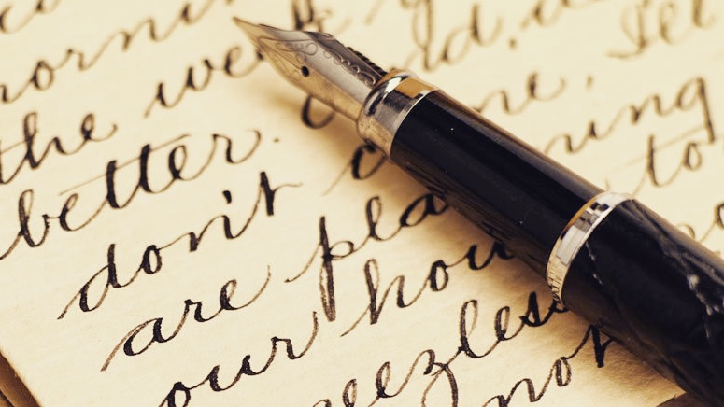
Introduction
“Graphology is the analysis of the physical characteristics and patterns of handwriting claiming to be able to identify the writer, indicating the psychological state at the time of writing, or evaluating personality characteristics.”

Slide 3
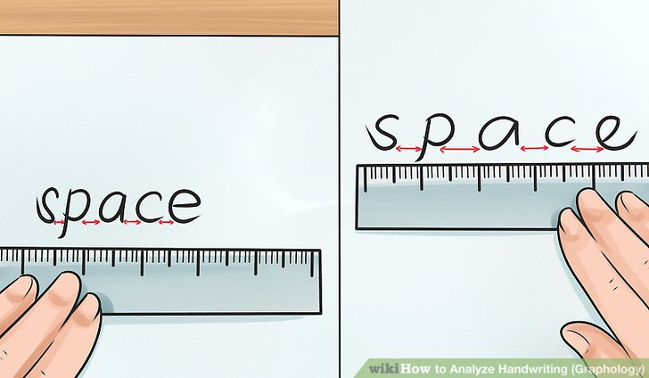
Features of Handwriting
Baseline
Upward
Downward
Pen Pressure
Heavy
Light
Word Spacing
Wide
Narrow

Slide 4
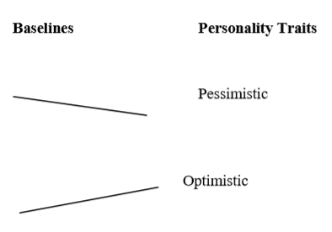

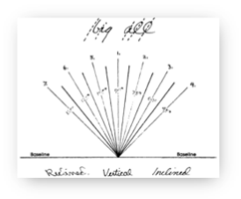
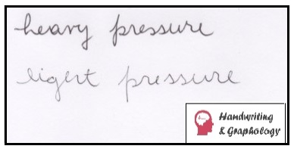
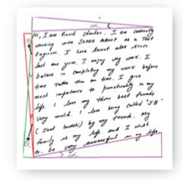

Literature Review
6000 companies the US have used Graphology for recruitment
-R C D Wulansari , I Primiana and M Kusman
Techniques:
Template Matching
Polygonization
Statistical Functions
ML Algorithms: SVM, Neural Networks

Slide 5
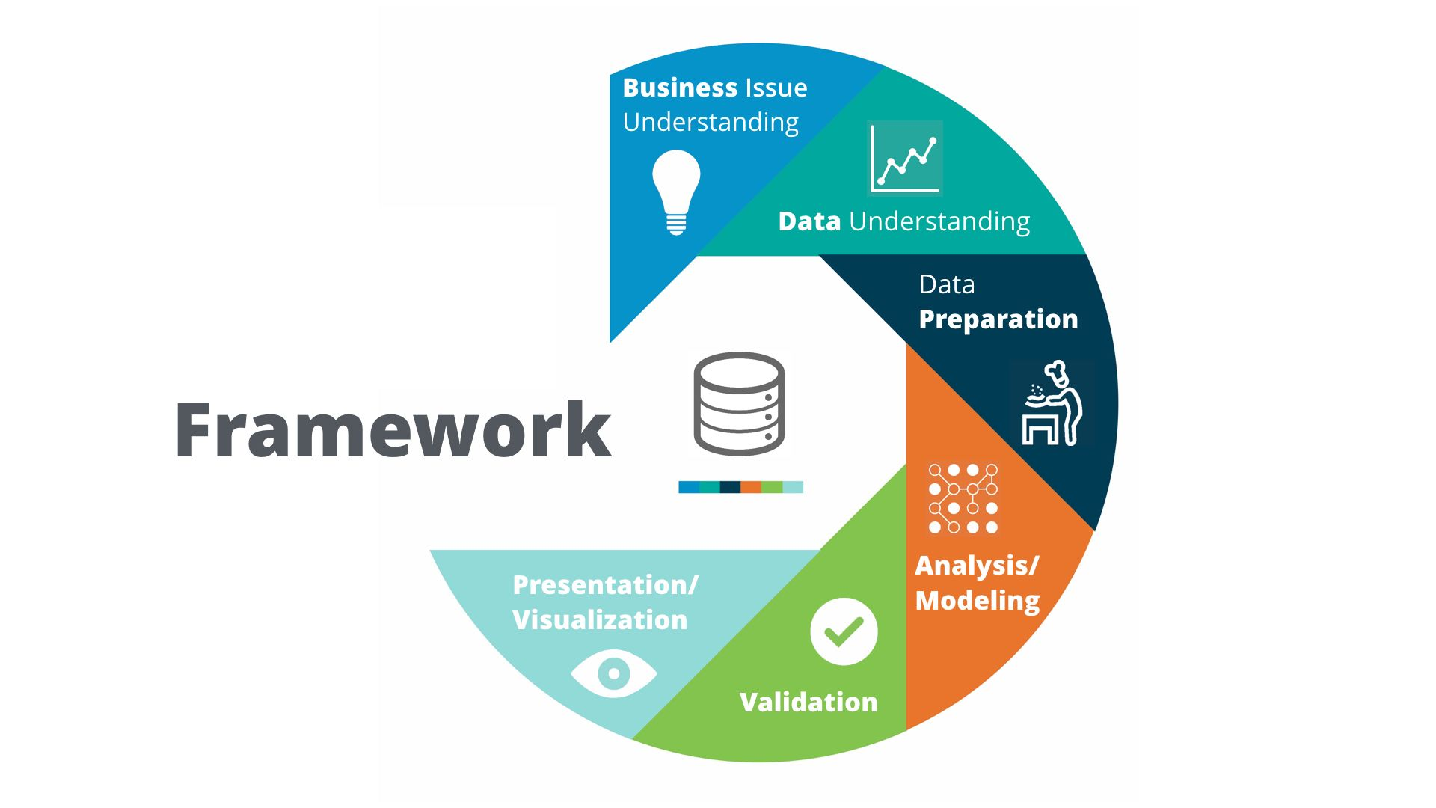
Methodology CRISP-DM

Slide 6

Business Understanding
Recruitment Management Selection
Corporate Training
Security Checking
Career Guidance
Compatibility Assessments
Personality Profiling
Historical Profiling
Notes:
Recruitment where it is an invaluable aid because an experienced graphologist can pick out the best candidates, and advise over suitability.
Management selection in commerce and industry where it is employed in conjunction with psychometric testing.
Corporate training where it can highlight staff strengths and flag up weaknesses, potential and motivation.
Security checking and the evaluation of honesty and integrity.
Career guidance for those seeking employment or a change of direction.
Compatibility assessments for business and personal relationships.
Personality profiling for individuals seeking self awareness for self development.
Child and family guidance to help resolve sensitive issues.
Historical profiling for genealogists and biographers who want to learn more about people who have died.
Document examination and forensic analysis for assessing forgeries and poison pen issues. (Note: B.I.G. tutors do not teach this specialist area.)

Slide 7
Data Understanding
Graphology
Feature selection and understanding
Identifying behavioural traits
Dataset feasibility

Slide 8
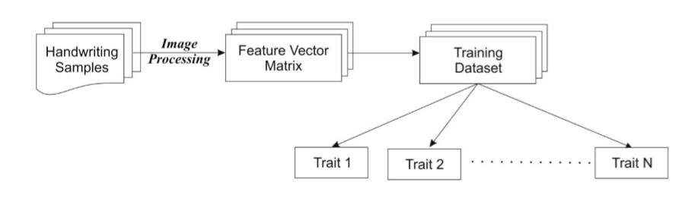
Data Preparation
Data Source: CVL dataset
Data Cleaning
Manually mapping traits to images
Mathematical segregation of handwriting features using Python

Slide 9
Baseline - Emotional control
Upward - Optimist
Downward - Pessimist

Slide 10
Word Spacing – Social Behaviour
Wide - Independent
Narrow - Insecure

Slide 11
Pen Pressure – Energy (Physical/Emotional)
Light – Gentle/Low Energy
Heavy – Intense/High Energy

Slide 12
Analysis and Modelling
Comparison between 5 models:
Decision Tree
Naïve Bayes
Support Vector Machine
K – Nearest Neighbours (KNN)
Random Forest

Slide 13
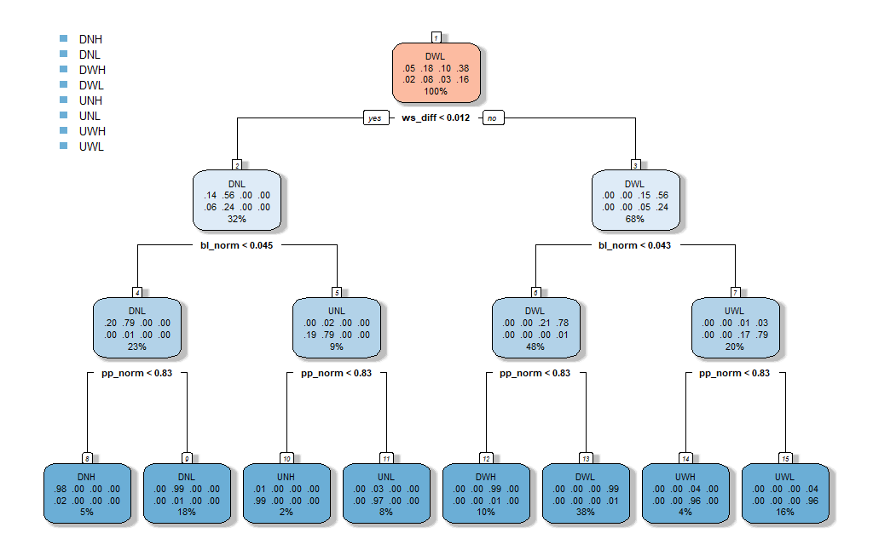
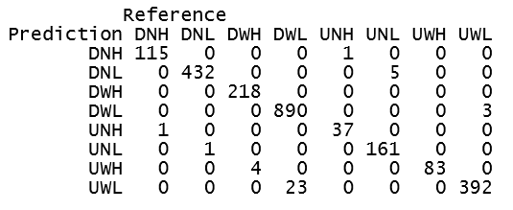
Decision Tree
Accuracy : 0.9839391

Slide 14
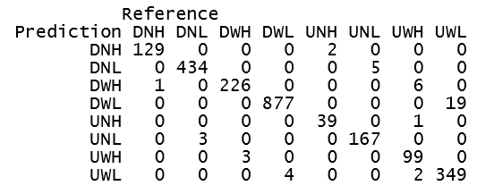
Naïve Bayes
Accuracy : 0.9805579

Slide 15
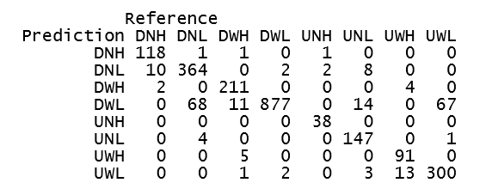
SVM Poly
Accuracy : 0.9070161

Slide 16
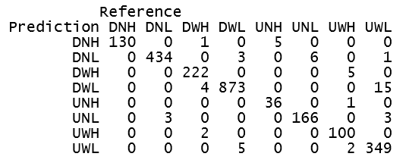
SVM Radial
Accuracy : 0.9763314

Slide 17
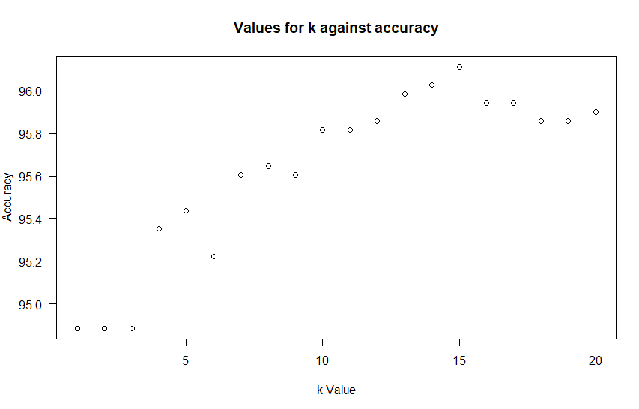
K – Nearest Neighbours (KNN)
Accuracy : 0.9611158

Slide 18
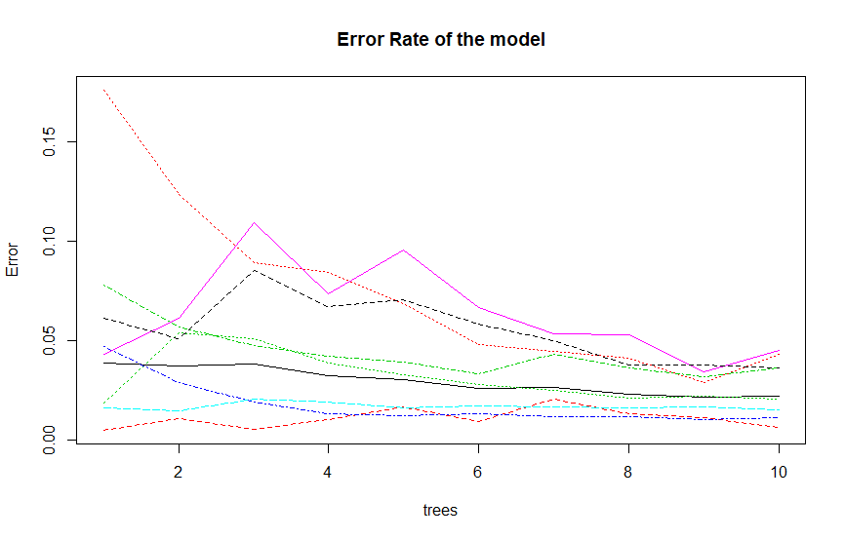
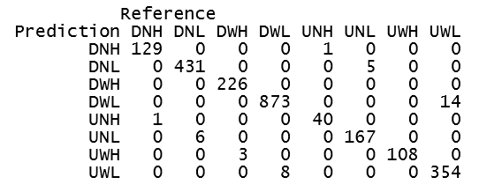
Random Forest
Accuracy : 0.9801352

Slide 19
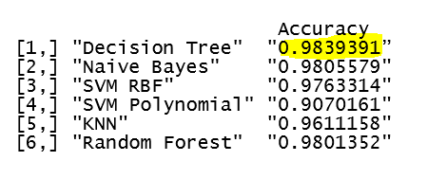
Final Comparision
Hence, Decision Tree is the best for this Predictive Model

Slide 20
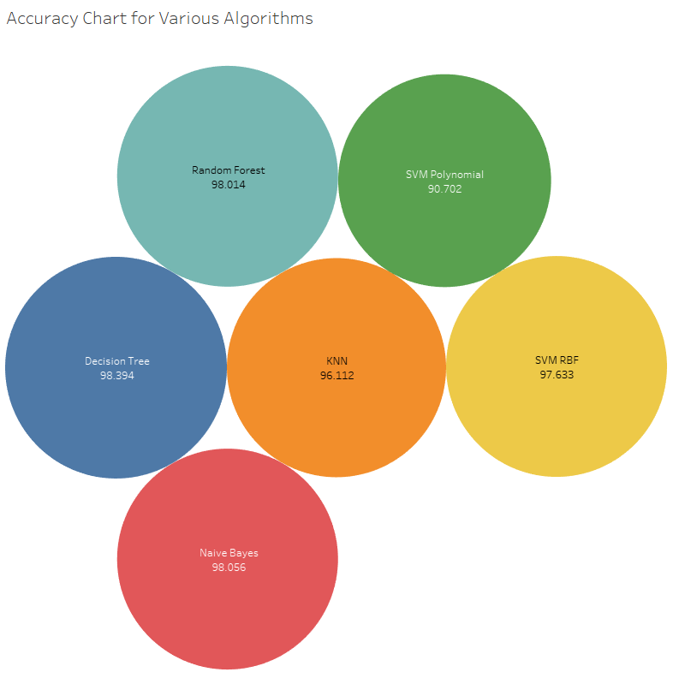
Evaluation: Performance Comparison

Slide 21


Conclusion
This paper successfully explores the human traits from various handwriting features like pen pressure, baseline, word spacing using machine learning approach.
The proposed system can be used as a complementary tool.

Slide 22
Future Works
Additional features:
Slant Margin ‘i’ dot
‘t’ bar Loops Zones
Expand to include personality indicators
Build R Shiny Application

Slide 23

Thank You

